Slide 1

Trees
Rem Collier
Room A1.02
School of Computer Science and Informatics
University College Dublin, Ireland

Slide 2
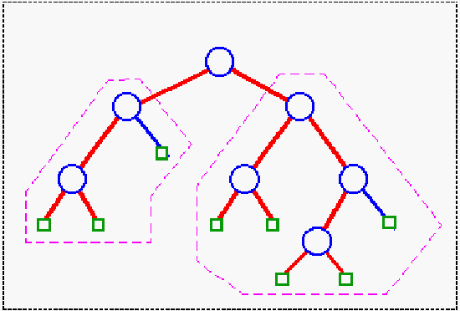
Trees: Introduction
A Tree is a hierarchical ADT where data is related in terms of parent-child relationships.
Each element (node) in the tree has at most 1 parent.
Each element (node) may have 0 or more children.
Each tree will include exactly one element (node), known as the root, which has no parent.
Trees can be defined recursively:
A tree T consists of a root node, r, plus a set of subtrees whose roots are children of r.

Slide 3
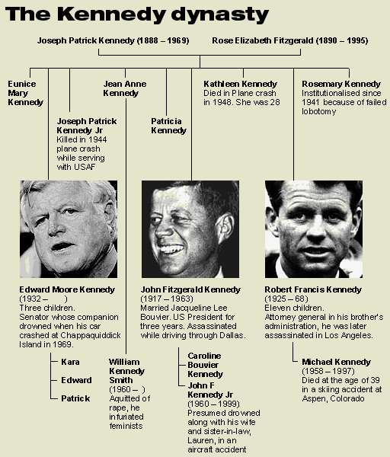
Trees: Introduction
A Tree is a hierarchical ADT where data is related in terms of parent-child relationships.
Each element (node) in the tree has at most 1 parent.
Each element (node) may have 0 or more children.
Each tree will include exactly one element (node), known as the root, which has no parent.
Trees can be defined recursively:
A tree T consists of a root node, r, plus a set of subtrees whose roots are children of r.
Trees occur throughout the real world:
Family Trees

Slide 4
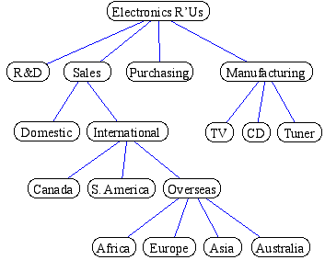
Trees: Introduction
A Tree is a hierarchical ADT where data is related in terms of parent-child relationships.
Each element (node) in the tree has at most 1 parent.
Each element (node) may have 0 or more children.
Each tree will include exactly one element (node), known as the root, which has no parent.
Trees can be defined recursively:
A tree T consists of a root node, r, plus a set of subtrees whose roots are children of r.
Trees occur throughout the real world:
Family Trees
Company Structures

Slide 5
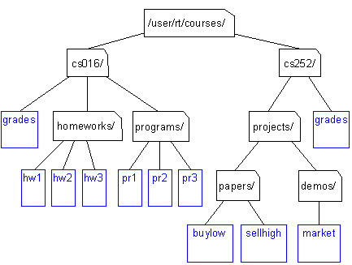
Trees: Introduction
A Tree is a hierarchical ADT where data is related in terms of parent-child relationships.
Each element (node) in the tree has at most 1 parent.
Each element (node) may have 0 or more children.
Each tree will include exactly one element (node), known as the root, which has no parent.
Trees can be defined recursively:
A tree T consists of a root node, r, plus a set of subtrees whose roots are children of r.
Trees occur throughout the real world:
Family Trees
Company Structures
File Systems

Slide 6
Trees: Terminology
Root of tree: A
The only node with no parent
A
B
C
D
E
F
G
I
H
J
K
L

Slide 7
Trees: Terminology
Root of tree: A
Parent of H: F
C is the parent of F
A is the parent of C
A
B
C
D
E
F
G
I
H
J
K
L

Slide 8
Trees: Terminology
Root of tree: A
Parent of H: F
Children of J: K and L
K is a child of J
L is a child of J
A
B
C
D
E
F
G
I
H
J
K
L

Slide 9
Trees: Terminology
Root of tree: A
Parent of H: F
Children of J: K and L
Sibling of F: G
Sibling of G: F
J does not have a sibling!
A
B
C
D
E
F
G
I
H
J
K
L

Slide 10
Trees: Terminology
Root of tree: A
Parent of H: F
Children of J: K and L
Sibling of F: G
Internal Nodes: A, B, I
Any node that has children
A
B
C
D
E
F
G
I
H
J
K
L

Slide 11
Trees: Terminology
Root of tree: A
Parent of H: F
Children of J: K and L
Sibling of F: G
Internal Nodes: A, B, I
External Nodes: D, H, L
Any node that has no children
Also known as leaves
A
B
C
D
E
F
G
I
H
J
K
L

Slide 12
Trees: Terminology
Root of tree: A
Parent of H: F
Children of J: K and L
Sibling of F: G
Internal Nodes: A, B, I
External Nodes: D, H, L
Ancestor of I: A, C, G, or I
A node u is an ancestor of v iff u = v or u is an ancestor of the parent of v (recursion!)
A
B
C
D
E
F
G
I
H
J
K
L

Slide 13
Trees: Terminology
Root of tree: A
Parent of H: F
Children of J: K and L
Sibling of F: G
Internal Nodes: A, B, I
External Nodes: D, H, L
Ancestor of I: A, C, G, or I
Descendent of I: I, J, K, or L
A node v is a descendent of u if u is an ancestor of v
A
B
C
D
E
F
G
I
H
J
K
L

Slide 14
Trees: Terminology
Root of tree: A
Parent of H: F
Children of J: K and L
Sibling of F: G
Internal Nodes: A, B, I
External Nodes: D, H, L
Ancestor of I: A, C, G, or I
Descendent of I: I, J, K, or L
Edge: pair (u,v) s.t. u is the parent of v
E.g. (A, B), (G, I)
(A, G) is not an edge!!!
A
B
C
D
E
F
G
I
H
J
K
L

Slide 15
Trees: Terminology
Root of tree: A
Parent of H: F
Children of J: K and L
Sibling of F: G
Internal Nodes: A, B, I
External Nodes: D, H, L
Ancestor of I: A, C, G, or I
Descendent of I: I, J, K, or L
Edge: pair (u,v) s.t. u is the parent of v
Path: sequence (n1, ..., ni) s.t. consecutive nodes are edges
E.g. (A, C, G, I)
(A, B, G) is not an path!!!
A
B
C
D
E
F
G
I
H
J
K
L

Slide 16
Trees: Properties
Depth of a node, v: the number of ancestors of v excluding v itself.
Depth(A) = 0
Depth(G) = 2
Depth(E) = 2
Depth(K) = 5
Recursive definition for depth of a node, u:
u is the root: Depth(u) = 0
u is not the root: Depth(u) = 1 + Depth(Parent(u))
Depth is sometimes referred to as the level of the node in the tree.
Degree of a node, v: the number of children of v.
Degree(A) = 2, Degree(G) = 1, Degree(E) = 0
A
B
C
D
E
F
G
I
H
J
K
L

Slide 17
Trees: Properties
Height of a tree T: the maximum depth of an external node of T.
Height(T) = 5
Mathematically defined in terms of the height of a node, v:
v is external: Height(v) = 0
v is internal: Height(v) = 1 + max. Height of v’s children
Example:
Height(A) = 1 + max(Height(B), Height(C))
Height(B) = 1 + max(Height(D), Height(E))
Height(D) = Height(E) = 0
...
A
B
C
D
E
F
G
I
H
J
K
L

Slide 18
Tree ADT
Trees make use of the Position ADT and have the following operations:
root() returns the Position for the root
parent(p) returns the Position of p’s parent
children(p) returns an Iterator of the Positions of p’s children
isInternal(p) does p have children?
isExternal(p) is p a leaf?
isRoot(p) is p==root()?
size() number of nodes
isEmpty() tests whether or not the tree is empty
iterator() returns an Iterator of every element in the tree
positions() returns an Iterator of every Position in the tree
replace(p, e) replaces the element at Position p with e

Slide 19
Tree Interface
public interface Tree<T> {
public Position<T> root();
public Position<T> parent(Position<T> p);
public Iterator<Position<T>> children(Position<T> p);
public boolean isInternal(Position<T> p);
public boolean isExternal(Position<T> p);
public boolean isRoot(Position<T> p);
public int size();
public boolean isEmpty();
public Iterator<T> iterator();
public Iterator<Position<T>> positions();
public T replace(Position<T> p, T t);
}

Slide 20
Binary Trees

Slide 21
Binary Tree
A Binary Tree is a tree with the following properties:
Every node has at most 2 children (degree 2)
Each child node is labelled as being either a left child or a right child
A left child precedes a right child in the ordering of children of a node
Proper Binary Tree: a Binary Tree in which all nodes have degree 0 or 2.
A Binary Tree, T, is either empty or combines:
a node r, called the root of T, which stores an element
a binary tree, called the left subtree of T
a binary tree, called the right subtree of T
Level Property: Level d of a binary tree is the set of all nodes with depth d, of which there are at most 2^{d} nodes.

Slide 22
Example: Arithmetic Operations
(1 + 3) x (7 – (2 + 1))
↓
x
+
-
1
3
7
+
2
1

Slide 23
Binary Tree ADT
Binary Tree ADT = Tree ADT + 4 extra operations:
left(p) return the Position of p’s left child
right(p) return the Position of p’s right child
hasLeft(p) test whether p has a left child
hasRight(p) test whether p has a right child
The corresponding Java Interface mirrors this:
public interface BinaryTree<T> extends Tree<T> {
public Position<T> left(Position<T> p);
public Position<T> right(Position<T> p);
public boolean hasLeft(Position<T> p);
public boolean hasRight(Position<T> p);
}
Again, no update methods are provided – these are left to the implementation strategy:
links vs arrays; proper vs standard

Slide 24
Tree Traversal

Slide 25
Tree Traversal
Systematic way of “visiting” or “processing” each node in the tree.
A very common operation:
print out each node’s label
add 10 to each node’s label
examine each node to find label “Elvis”
count total number of nodes
…
Q: But in which order are nodes visited??
A: many “standard” orders:
pre-order traversal
in-order traversal
post-order traversal
Euler traversal
breadth-first traversal (all nodes at depth=0, then depth=1, then depth=2)
Cover these now breadth first: discussed later

Slide 26
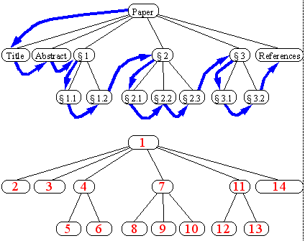
Pre-Order Tree Traversal
preorder traversal
Algorithm preOrder(v)
“visit” node v
for each child w of v do
recursively perform preOrder(w)
Reading a document from beginning to end
Don’t read a section until read all prior sections

Slide 27
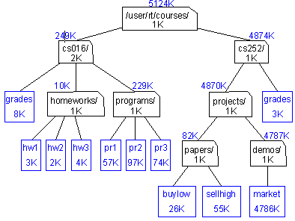
Post-Order Tree Traversal
postorder traversal
Algorithm postOrder(v)
for each child w of v do
recursively perform postOrder(w)
“visit” node v
du (disk usage) command in Unix
to compute value for parent,
must first visit
all children

Slide 28
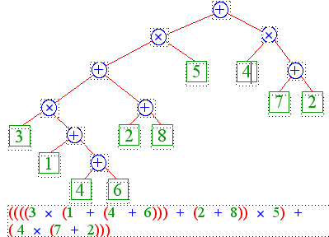
In-Order Tree Traversal
inorder traversal of a binary tree (inapplicable to non-binary trees)
algorithm inOrder(v)
recursively perform inOrder(leftChild(v))
“visit” node v
recursively perform inOrder(rightChild(v))
printing an arithmetic expression
specialization of an inorder traversal
print “(“ before traversing the left subtree
print “)” after traversing the right subtree
print operator between children

Slide 29
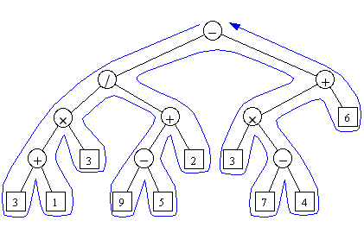
Euler Tour Tree Traversal
Generic traversal of a binary tree
the preorder, inorder, and postorder traversals are special cases of the Euler tour traversal
“walk around” the tree and visit each node three times:
on the left
from below
on the right

Slide 30
Comparison: Traversal Algorithms
preOrder:
1. visit this node
2. preOrder left child
3. preOrder right child
only difference is when this step occurs
inOrder:
1. inOrder left child
2. visit this node
3. inOrder right child
postOrder:
1. postOrder left child
2. postOrder right child
3. visit this node
Euler:
1. visit this node
2. postOrder left child
3. Visit this node
4. postOrder right child
5. visit this node

